Slide 1
Solar System Simulator
Jochen K. Illerhaus
Supervisor: Dr. Wojciech L. Gorlik
St. Charles (MO) Lindenwood University
School of Science
Institute of Mathematics
May 4, 2016

Slide 2
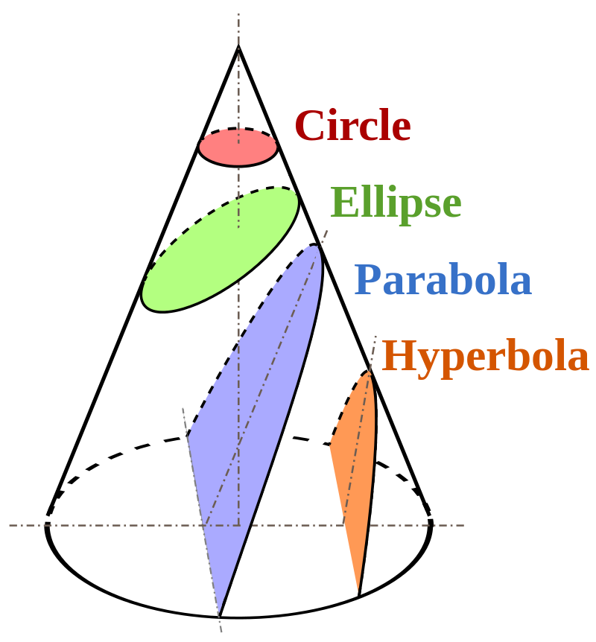
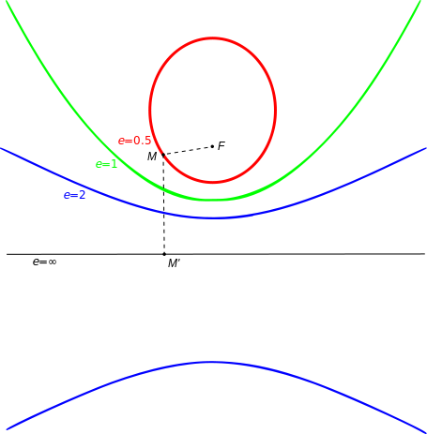
First Weak of Class
Source: https://en.wikipedia.org/wiki/Conic_section

Slide 3
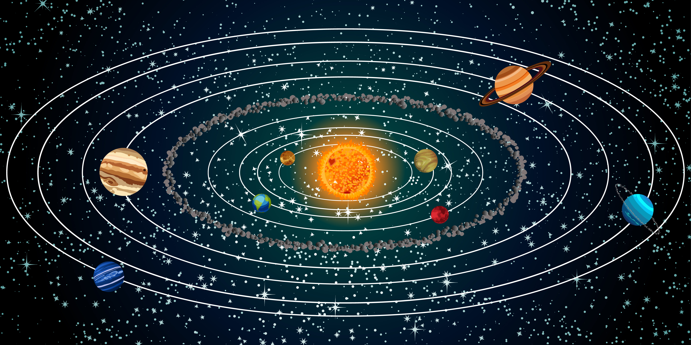
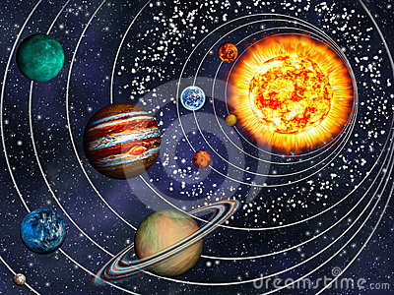
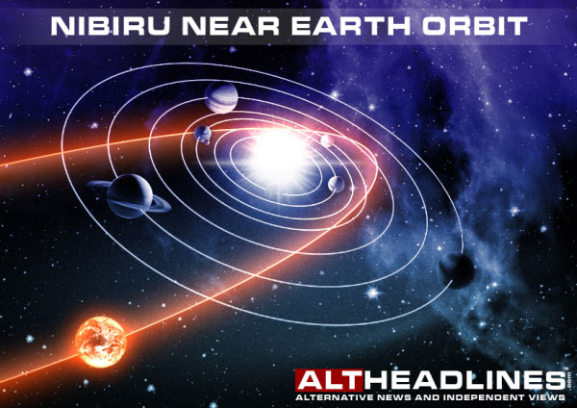
Source: http://www.altheadlines.com/nibiru-planet-x-13249127/

Slide 4
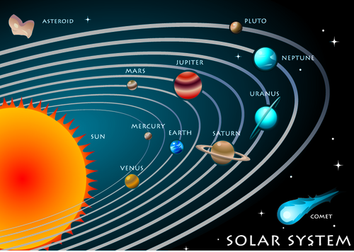
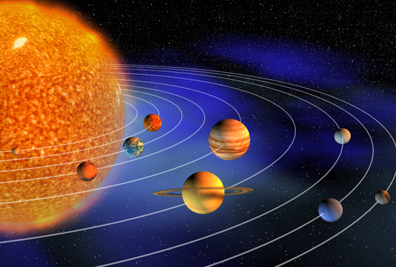
The Solar System
Source: http://www.bbc.co.uk/schools/primarylanguages_assets/french/images/our_world_solar_system.jpg
Notes:
Show the Programm:
General oberview: Planets orbiting the sun
Can be looked at form all directions

Slide 5
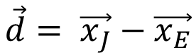
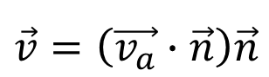
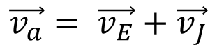
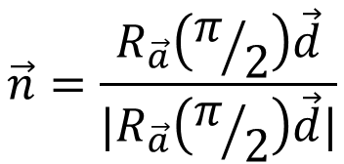
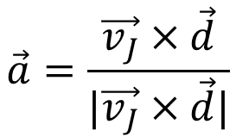
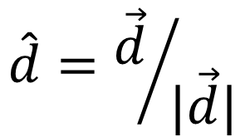
The TASK: Apparent Retrograde Motion
$$\vec{v_{a}}= \vec{v_{E}}+\vec{v_{J}}$$
$$\vec{d}= \vec{x_{J}}−\vec{x_{E}}$$
$$\hat{d}={\vec{d}}/{|\vec{d}|}$$
$$\vec{a}=\frac{\vec{v_{J}}×\vec{d}}{|\vec{v_{J}}×\vec{d}|}$$
J
$$\vec{n}=\frac{R_{\vec{a}}\left(π/2\right)\vec{d}}{|R_{\vec{a}}\left(π/2\right)\vec{d}|}$$
S
E
$$\vec{v}=\left(\vec{v_{a}}∙\vec{n}\right)\vec{n}$$

Slide 6
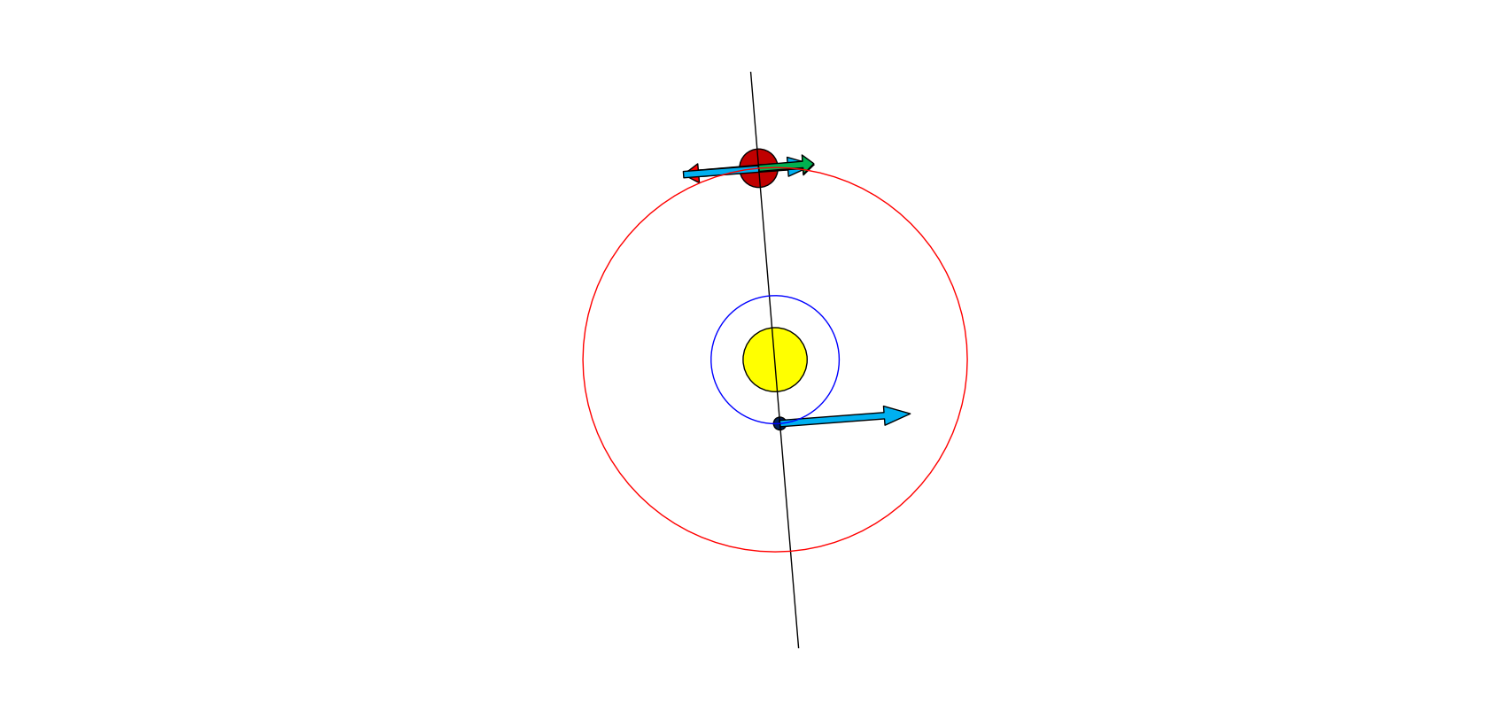
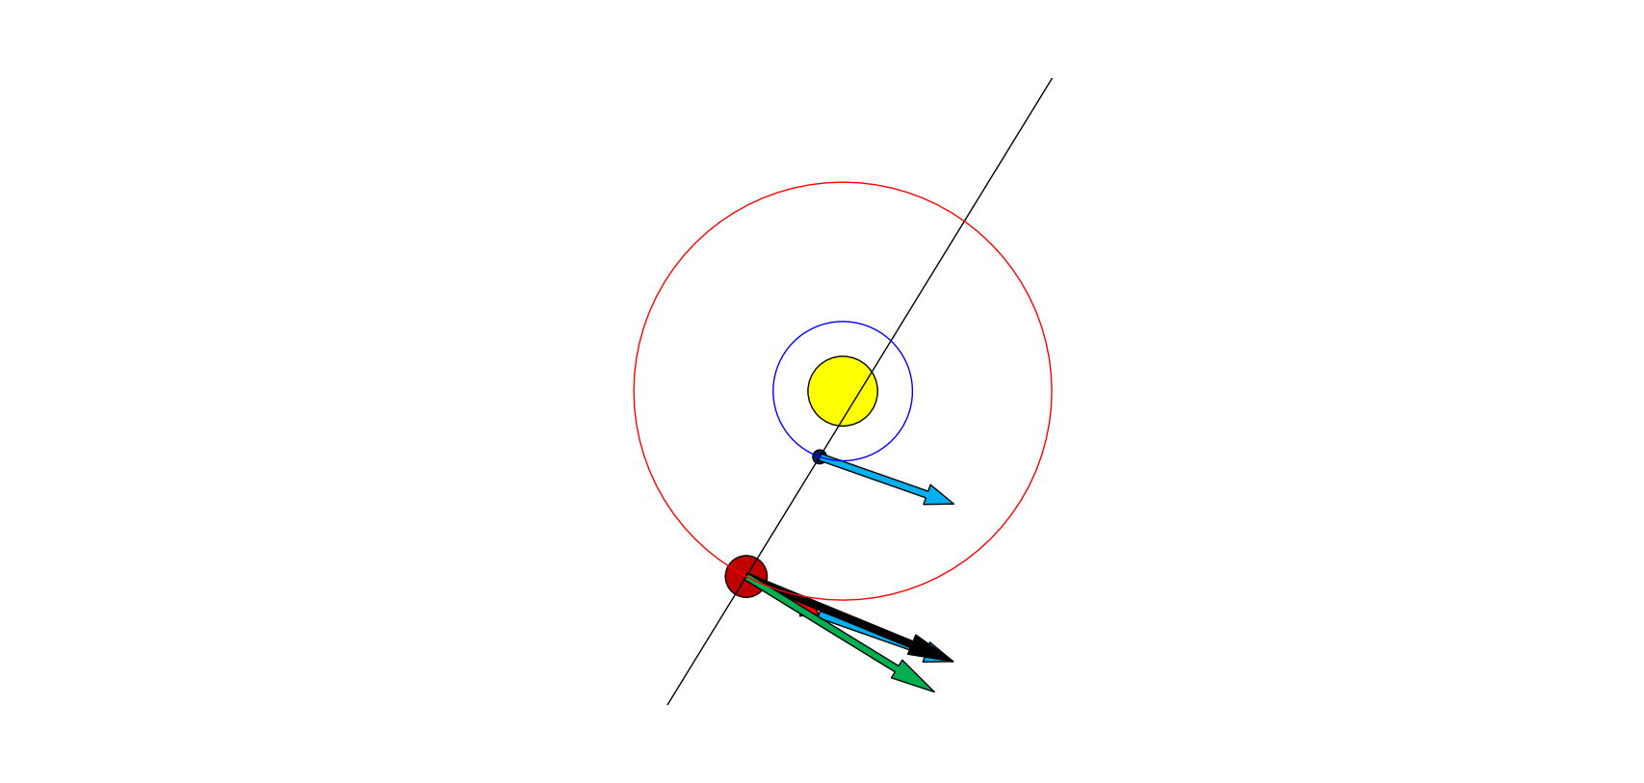
Apparent Velocity in 2D
RUN

Slide 7
Planetary retrograde constants
Planet | Synodic period, days | Synodic period, mean months | Days in retrograde
Mercury | 116 | 3.8 | ~21
Venus | 584 | 19.2 | 41
Mars | 780 | 25.6 | 72
Jupiter | 399 | 13.1 | 121
Saturn | 378 | 12.4 | 138
Uranus | 370 | 12.15 | 151
Neptune | 367 | 12.07 | 158
Hypothetical far out planet | 365.25 | 12 | 182.125
Source: https://en.wikipedia.org/wiki/Apparent_retrograde_motion

Slide 8
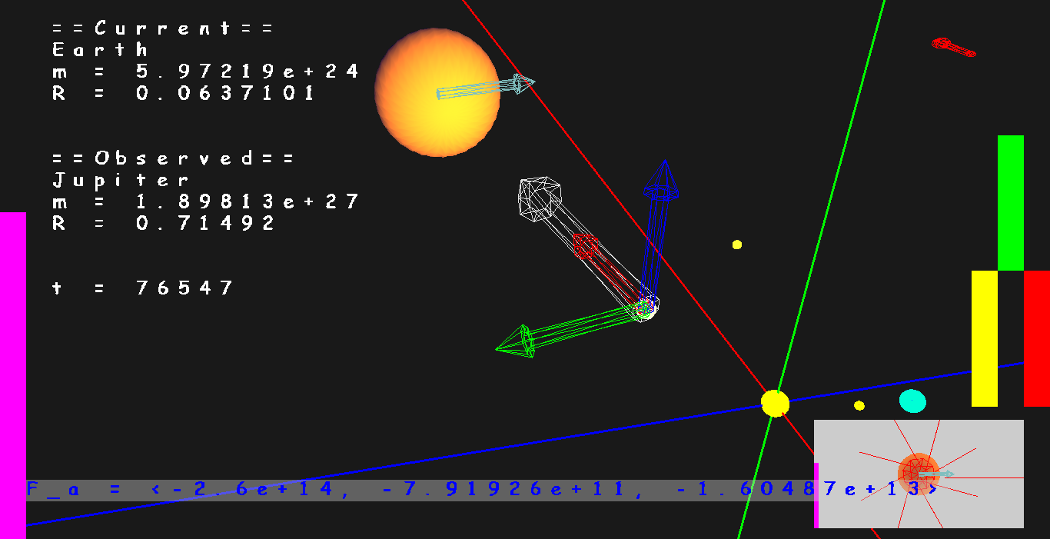

Slide 9
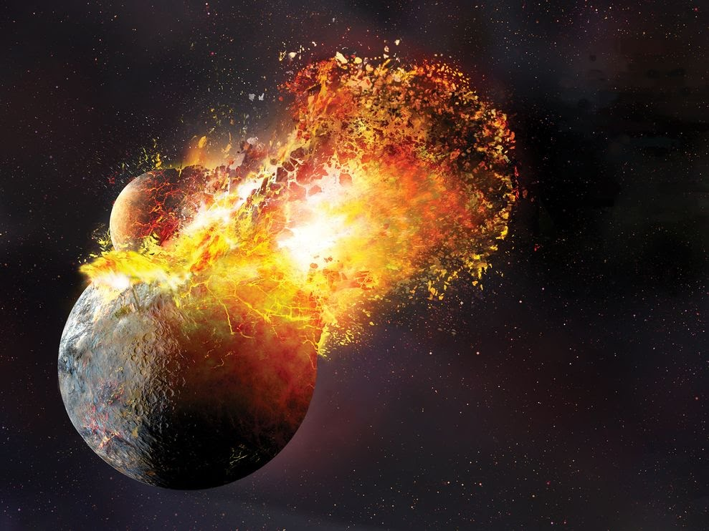
Source: https://bookofresearch.files.wordpress.com/2015/02/moon-formation-theories-debated_69202_990x742-640x480.jpg

Slide 10
END
Thank you for your attention. Do not hesitate to ask your questions.
j.illerhaus@live.de

Slide 11
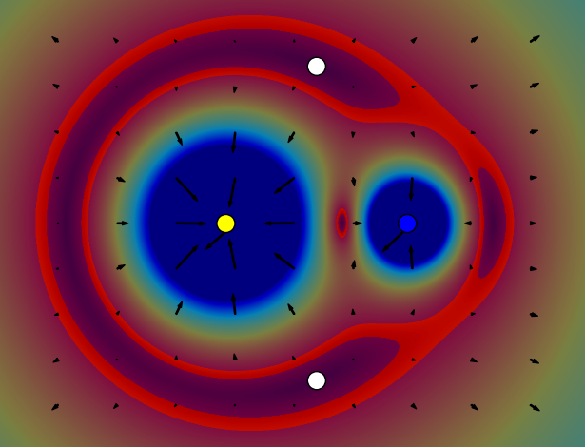

Slide 12
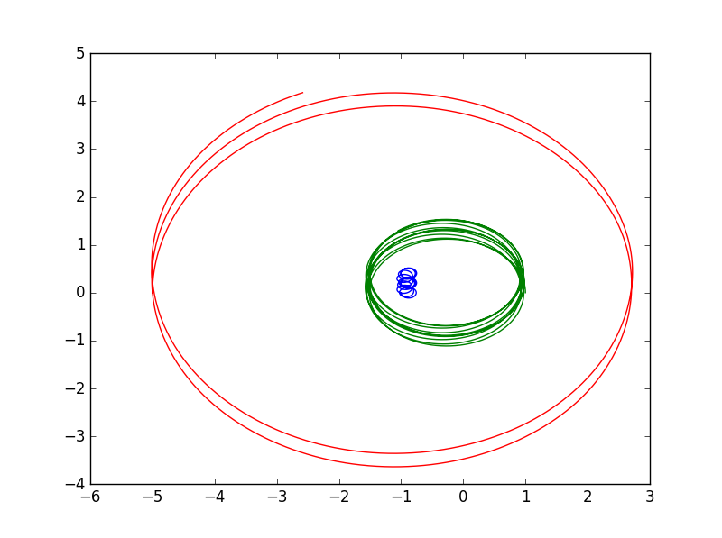
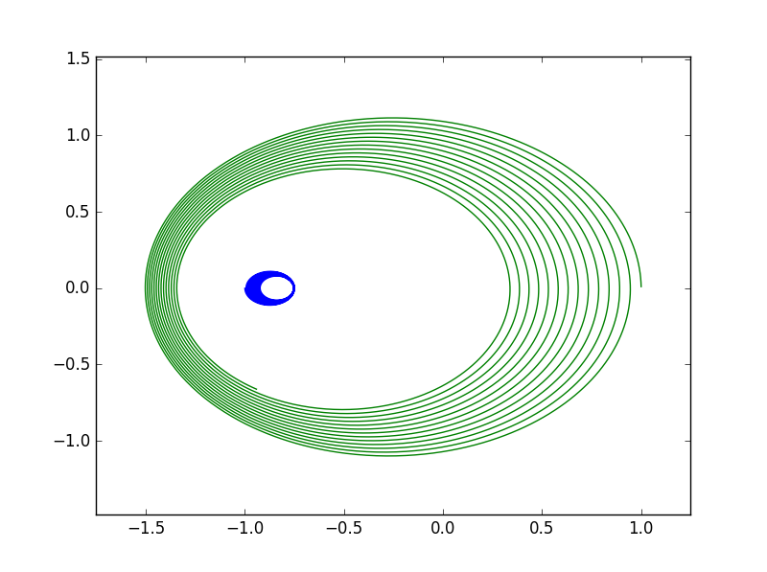
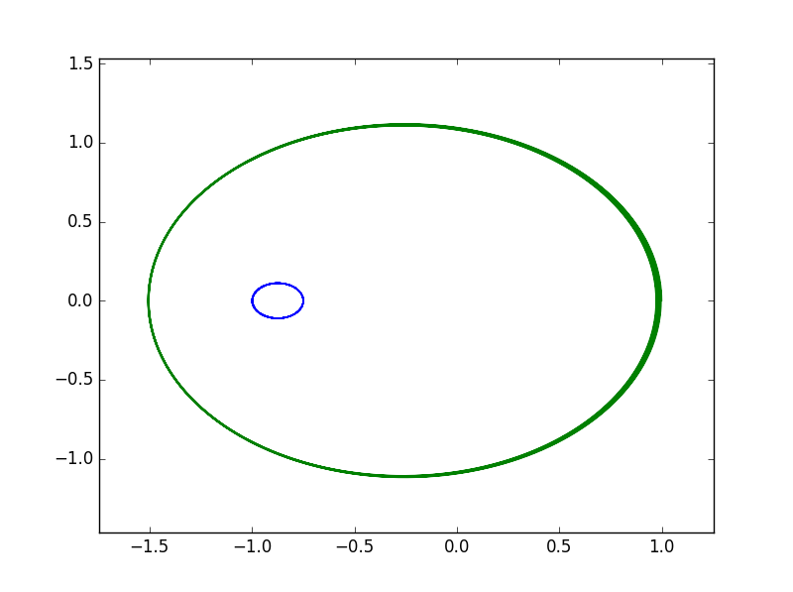
RUN

Slide 13
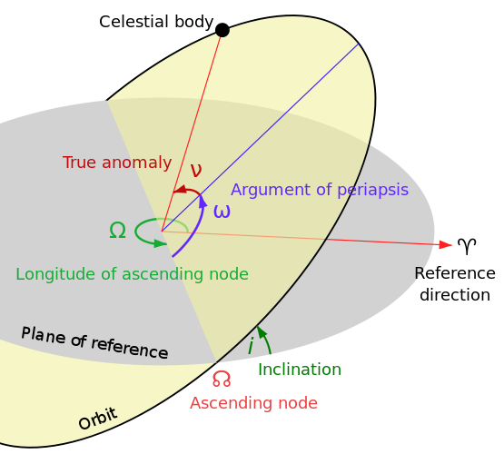
Source: https://en.wikipedia.org/wiki/Kepler_orbit#/media/File:OrbitalEccentricityDemo.svg
Source: https://en.wikipedia.org/wiki/Kepler_orbit#/media/File:Orbit1.svg

Slide 14
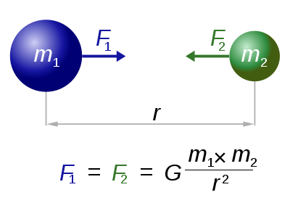
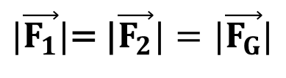
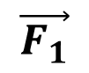
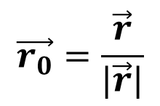
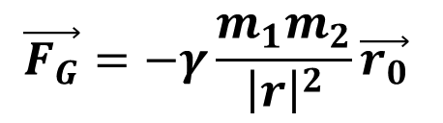
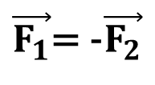
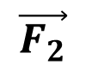
$\vec{F_{1}}$= -$\vec{F_{2}}$
$|\vec{F_{1}}|$= |$\vec{F_{2}}|=|\vec{F_{G}}|$
$$\vec{F_{2}}$$
$$\vec{F_{1}}$$
$$\vec{F_{G}}=−γ\frac{m_{1}m_{2}}{{\left|r\right|}^{2}}\vec{r_{0}}$$
$$\vec{r_{0}}=\frac{\vec{r}}{|\vec{r}|}$$
Source: https://en.wikipedia.org/wiki/Kepler_orbit#/media/File:NewtonsLawOfUniversalGravitation.svg

Slide 15
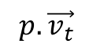
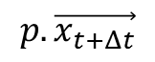
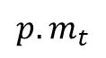
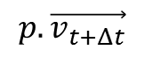
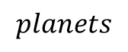
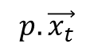
foreach p in planets:
$$p.\vec{x_{t}}$$
$$p.\vec{v_{t}}$$
Forces
velocities
positions
$$p.\vec{x_{t+Δt}}$$
$$p.m_{t}$$
$$p.\vec{v_{t+Δt}}$$
$$planets$$
Possibly output

Slide 16
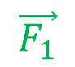

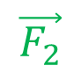
$$\vec{F}$$
$$\vec{F_{2}}$$
$$\vec{F_{1}}$$

Slide 17
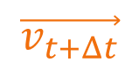
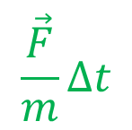
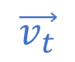
$$\vec{v_{t+Δt}}$$
$$\frac{\vec{F}}{m}Δt$$
$$\vec{v_{t}}$$

Slide 18
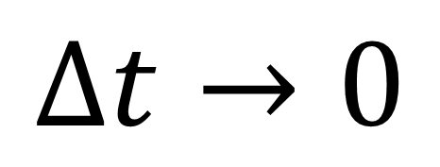
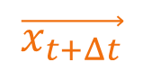
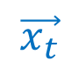
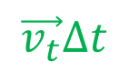
$$\vec{v_{t}}Δt$$
$$\vec{x_{t+Δt}}$$
$$\vec{x_{t}}$$
y
$$Δt→0$$
z
x

Slide 19
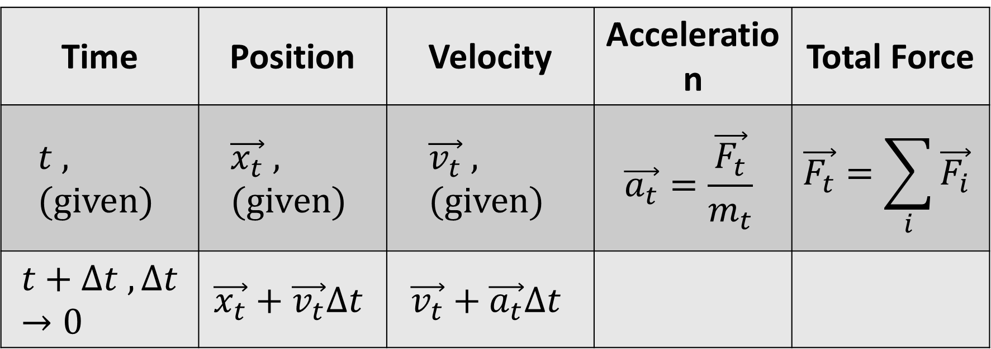
Equations
Time | Position | Velocity | Acceleration | Total Force
$$t , (given)$$ | $$\vec{x_{t}} , (given)$$ | $$\vec{v_{t}} , (given)$$ | $$\vec{a_{t}}=\frac{\vec{F_{t}}}{m_{t}}$$ | $$\vec{F_{t}}=\sum_{i}{\vec{F_{i}}}$$
$$t+Δt , Δt→0$$ | $$\vec{x_{t}}+\vec{v_{t}}Δt$$ | $$\vec{v_{t}}+\vec{a_{t}}Δt$$

Slide 20


Slide 21
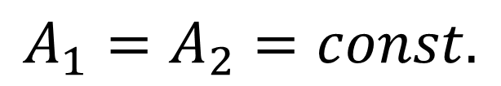
Keplers Law
$$A_{1}=A_{2}=const.$$

Slide 23
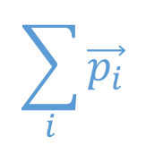
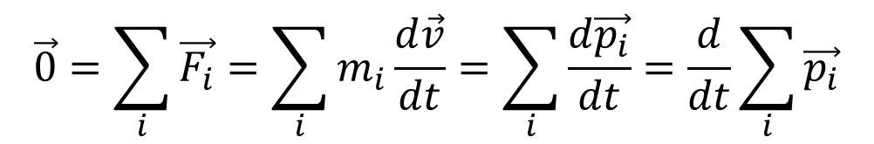
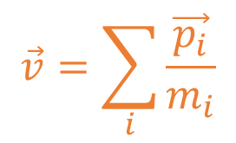
$$\vec{0}=\sum_{i}{\vec{F_{i}}=\sum_{i}{m_{i}\frac{d\vec{v}}{dt}=\sum_{i}{\frac{d\vec{p_{i}}}{dt}}=\frac{d}{dt}\sum_{i}{\vec{p_{i}}}}}$$
$$\sum_{i}{\vec{p_{i}}}$$
$$\vec{v}=\sum_{i}{\frac{\vec{p_{i}}}{m_{i}}}$$

